Slide 1

Beers & Breweries
An analysis of US Craft Beers and breweries

Slide 2
Analysis Goals
Analyze data sample of 2410 beers and 558 breweries with focus on Alcohol by Volume (ABV) and International Bitterness Unit (IBU)
Analysis Highlights
Breweries per-state
Median alcohol content per-state
Median bitterness per-state
Beers with highest ABV and IBU
Summary stats of ABV
Analysis of relationship between ABV and IBU
Note: Missing 2% of ABV data and 42% IBU data from data sets provided

Slide 3
States and Breweries
Range of 1-47 breweries per-state
10.9 average number of craft breweries per-state
Colorado leads with 47 Craft breweries
Only 1 Craft Brewery ND, SD, WV

Slide 4
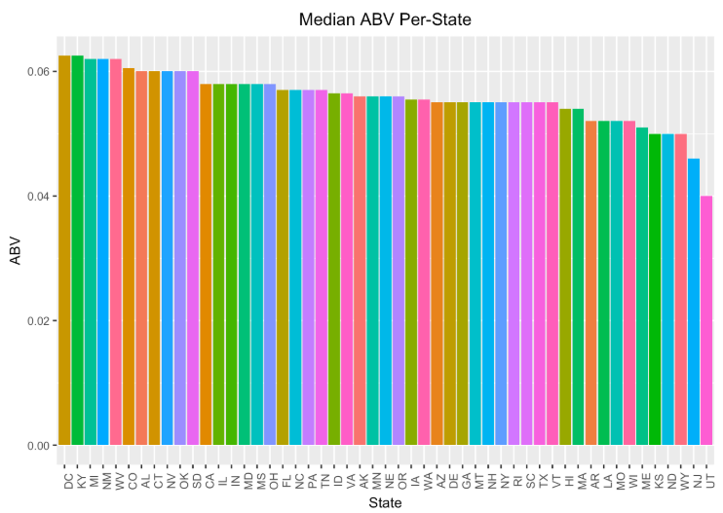
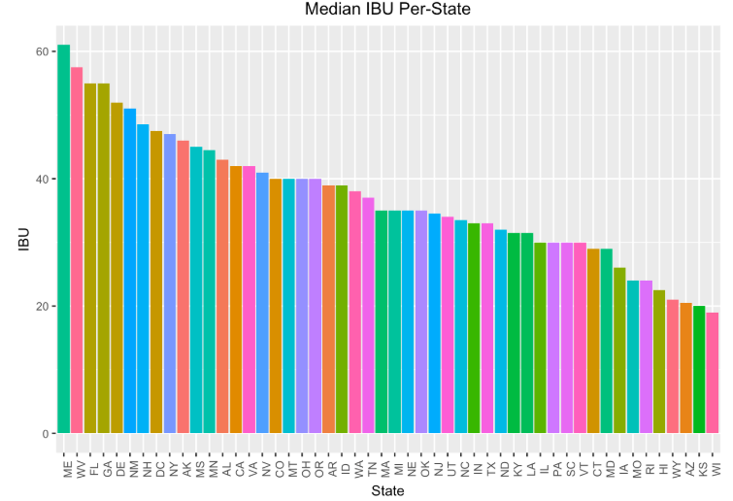
Median ABV & IBU Per-State
A
B

Slide 5
Highest ABV and IBU Beers
Highest ABV
Lee Hill Series Vol. 5
.128 ABV (13%)
Upslope Brewing Company Boulder, CO
Highest IBU
Bitter Bitch Imperial IPA
138 IBU
Astoria Brewing Co. Astoria, OR

Slide 6
ABV Summary Statistics
Measure | Value
Min | .001
Median | 5.6%
Mean | 5.9%
Max | 13%
Missing values | 62

Slide 7
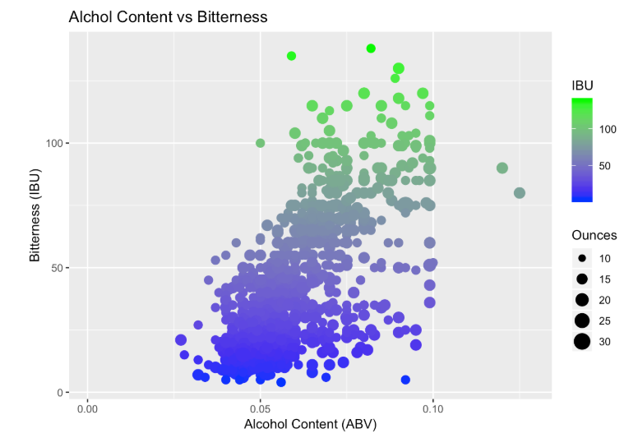
Alcohol Content vs Bitterness

Slide 8
Full analysis can be viewed in the GIT repository below.
https://github.com/Chinchillin1981/CaseStudy1_Matt_Paritosh

